Slide 1
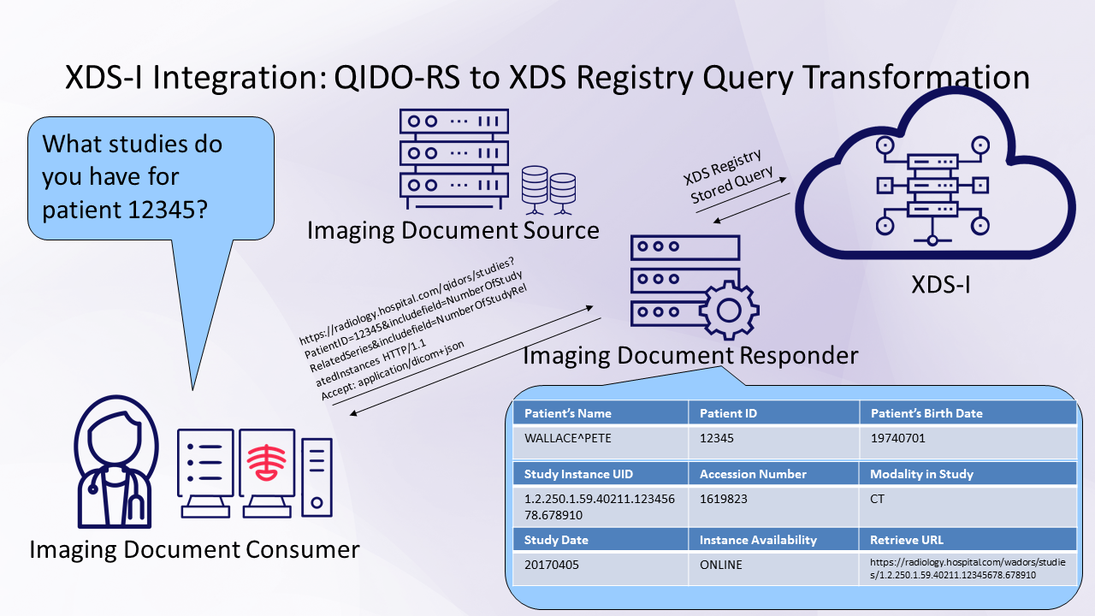
Dicom Restful services
QIDO - RS
Query Requester (Search for Study, Series or Instance DICOM Objects)
WADO-RS
DICOM Requester (Retrieve Study, Series, or Instance DICOM Objects)
STOW -RS
DICOM Creator (Store Instances)

Slide 3
python libraries
Dicom trolley - pull and saves to directory
Dicom-webclient - push and pull the dicoms and saves to directory
Dicompopulate - push the dicom using tcp/ip

